Slide 1
Line Drawings for Face Portraits from Photos using Global and Local Structure based GANs
(IEEE T-PAMI 2020)
JONGWOOK-SI

Slide 2
Abstract
APDrawings로 변환하기 위한 APDrawingGAN++을 제안한다.
큰 불일치에 불이익을 주면서 작은 잘못 정렬한 것으로 라인 처리
더 연속적인 선을 생성하는 작업을 해결
비선형 매핑을 사용한 거리 변환 손실과 새로운 라인 연속성 손실은 품질 향상

Slide 3
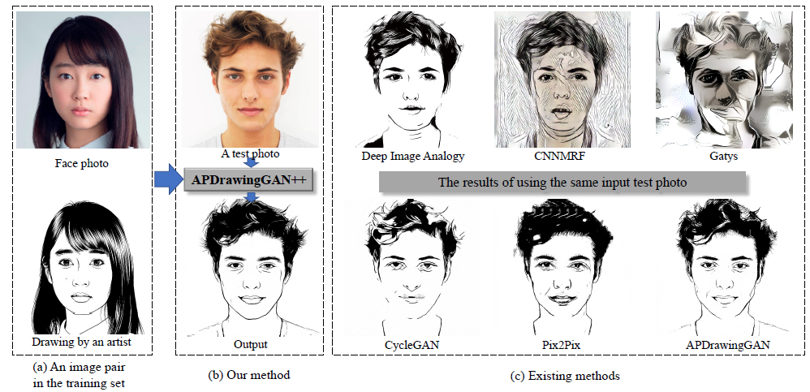
Introduction

Slide 4
Introduction
이 논문에서는 APDrawingGAN을 개선하고 섬세한 얼굴 특징을 학습하여 생성할 수 있는 APDrawingGAN ++ 제안
Network 구조
APDrawingGAN : Residual Block있는 CNN을 사용하여 APDrawing 형식으로 변환
APDrawingGAN++ : APDrawingGAN에 Auto Encoder를 추가하여 Fine tuning

Slide 5
Introduction
Loss Function
ApDrawingGAN++에는 새로운 line continuity loss 도입
DT loss를 계산하기 전에 nonlinear mapping을 적용
Kept cleaner by strongly penalizing large misalignments while tolerating small misaliganments, which are typically present in artist drawings.

Slide 6
Introduction
Training Scheme
APDrawingGAN과 동일한 데이터세트 사용
데이터 세트 내에서 서로 다른 피부 색상의 불균형 해결 : Histogram Matching
APDrawingGAN++이 어두운 얼굴에 대해 더 나은 결과를 얻을 수 있다.
Why? 해당 데이터세트 내에는 어두운 얼굴이 없기 때문.

Slide 7
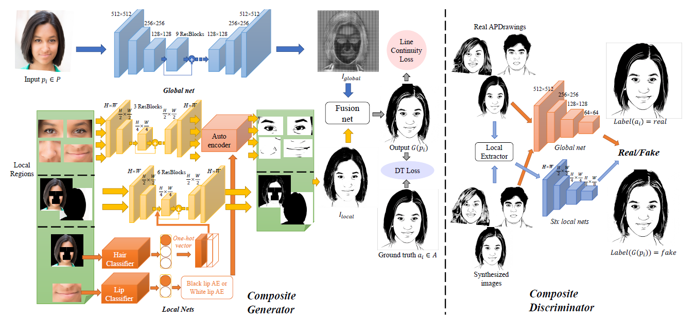
Overview of APDrawingGAN++
overview

Slide 8
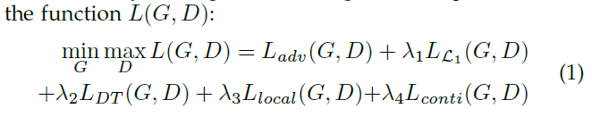
Overview of APDrawingGAN++
overview
$S_{data}= \left\{\left(p_{i}, a_{i}\right)| p_{i} ε 𝒫, a_{i}ε 𝒜, i=1, 2,…, N\right\}$

Slide 9
Network Architecture
Introduction
Different from APDrawingGAN, they introduce auto-encoders into the generator network to further improve local fine details in APDrawings.
To cope with six combinations for two lips styles and three hair styles, they introduce two classifiers for lips and hair
The output of the classifiers is used to guide the local generators/auto encoders towards on of the target styles.

Slide 10
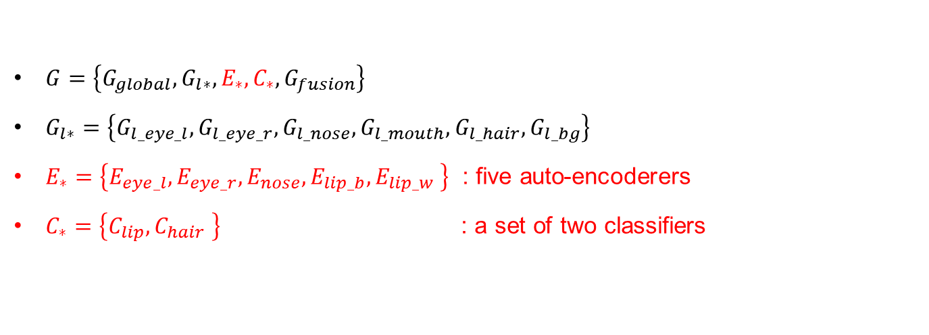
Network Architecture
Composite generator G
$G=\left\{G_{global}, G_{l∗}, E_{∗}, C_{∗}, G_{fusion}\right\}$
$G_{l∗}=\left\{G_{l_eye_l},G_{l_eye_r},G_{l_nose},G_{l_mouth},G_{l_hair},G_{l_bg}\right\}$
$E_{∗}=\left\{E_{eye_l},E_{eye_r},E_{nose},E_{lip_b},E_{lip_w} \right\}$ : five auto-encoderers
$C_{∗}=\left\{C_{lip},C_{hair} \right\}$ : a set of two classifiers

Slide 11
Network Architecture
Local Generators
Subtle facial features and hair in APDrawingGAN : not artistically beautiful
APDrawingGAN++
1) rough APDrawing
2) using two lip and hair classifiers at a fine level
3) applies trained auto-encoders to transform rough APDrawing portions
4) fused together

Slide 12
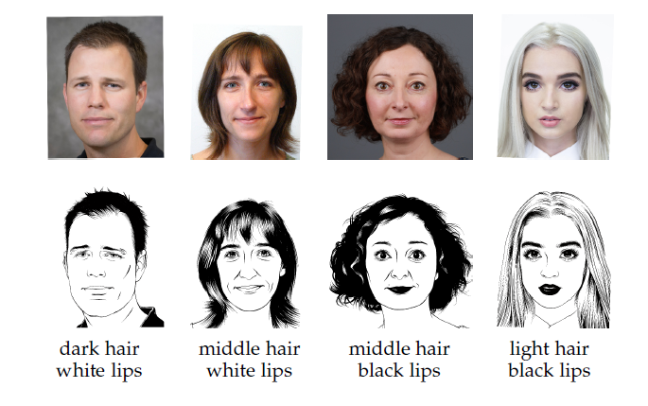
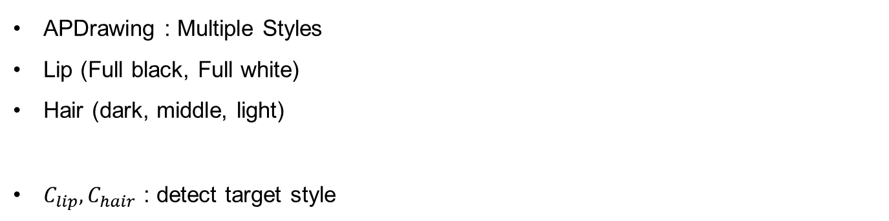
Network Architecture
Style-control classifiers for lips and hair
APDrawing : Multiple Styles
Lip (Full black, Full white)
Hair (dark, middle, light)
$C_{lip},C_{hair}$ : detect target style

Slide 13
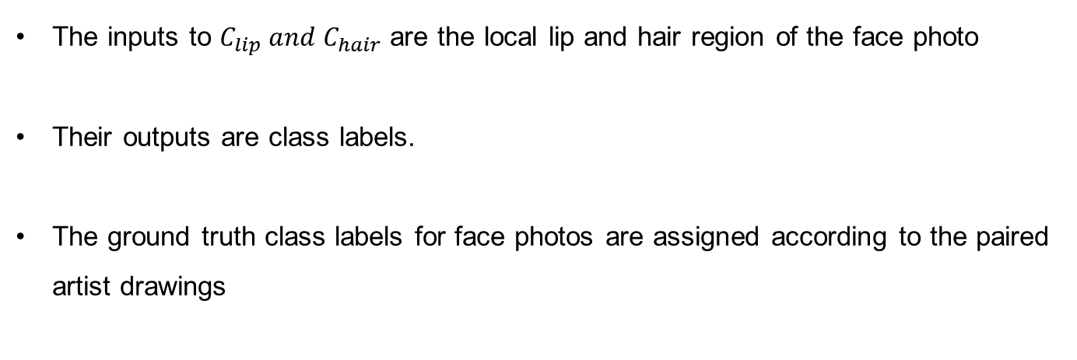
Network Architecture
Style-control classifiers for lips and hair
The inputs to $C_{lip} and{ C}_{hair}$ are the local lip and hair region of the face photo
Their outputs are class labels.
The ground truth class labels for face photos are assigned according to the paired artist drawings

Slide 14
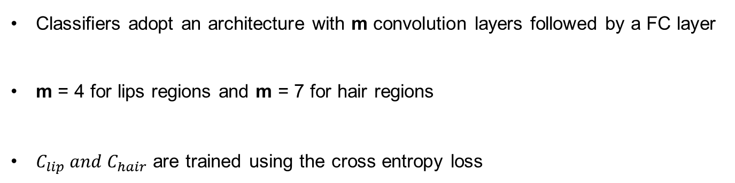
Network Architecture
Style-control classifiers for lips and hair
Classifiers adopt an architecture with m convolution layers followed by a FC layer
m = 4 for lips regions and m = 7 for hair regions
$C_{lip} and{ C}_{hair}$ are trained using the cross entropy loss

Slide 15
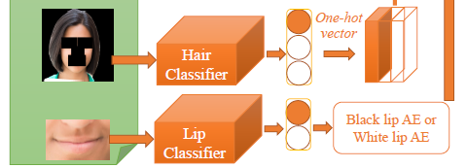
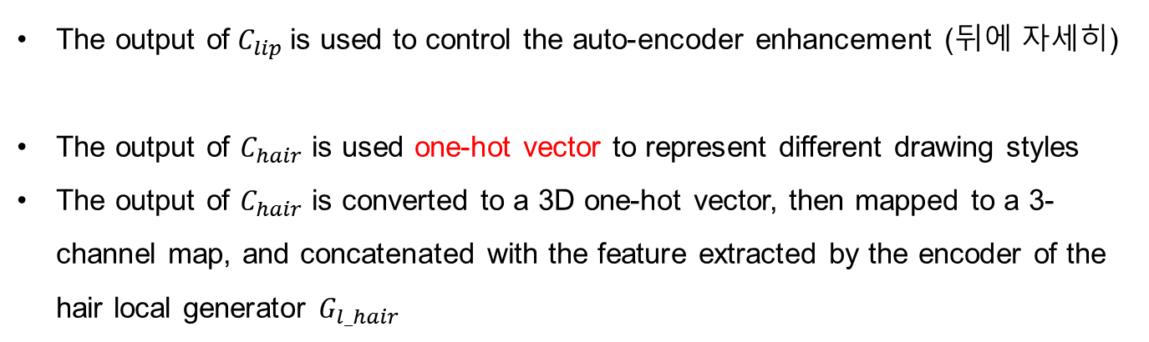
Network Architecture
Style-control classifiers for lips and hair
The output of $C_{lip}$ is used to control the auto-encoder enhancement (뒤에 자세히)
The output of $C_{hair}$ is used one-hot vector to represent different drawing styles
The output of $C_{hair}$ is converted to a 3D one-hot vector, then mapped to a 3-channel map, and concatenated with the feature extracted by the encoder of the hair local generator $G_{l_hair}$

Slide 16
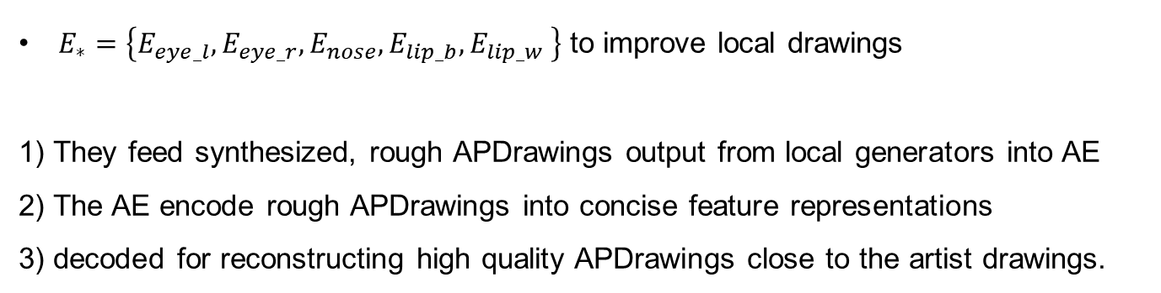
Network Architecture
Auto-encoders for subtle facial features
$E_{∗}=\left\{E_{eye_l},E_{eye_r},E_{nose},E_{lip_b},E_{lip_w} \right\}$ to improve local drawings
1) They feed synthesized, rough APDrawings output from local generators into AE
2) The AE encode rough APDrawings into concise feature representations
3) decoded for reconstructing high quality APDrawings close to the artist drawings.

Slide 17
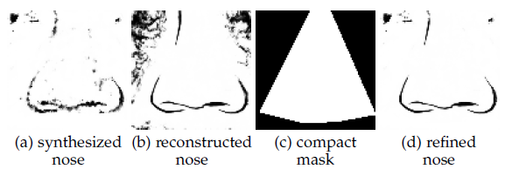
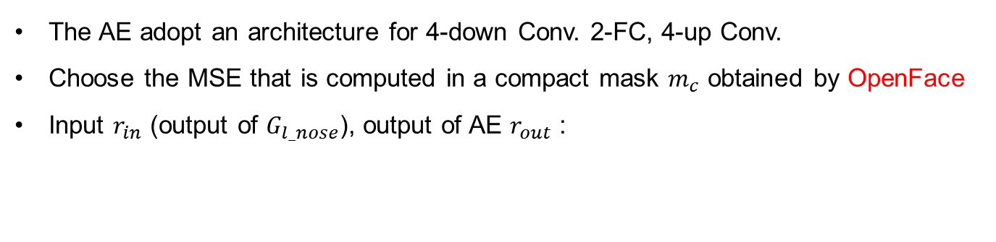
Network Architecture
Auto-encoders for subtle facial features
The AE adopt an architecture for 4-down Conv. 2-FC, 4-up Conv.
Choose the MSE that is computed in a compact mask $m_{c}$ obtained by OpenFace
Input $r_{in}$ (output of $G_{l_nose}$), output of AE $r_{out}$ :

Slide 18
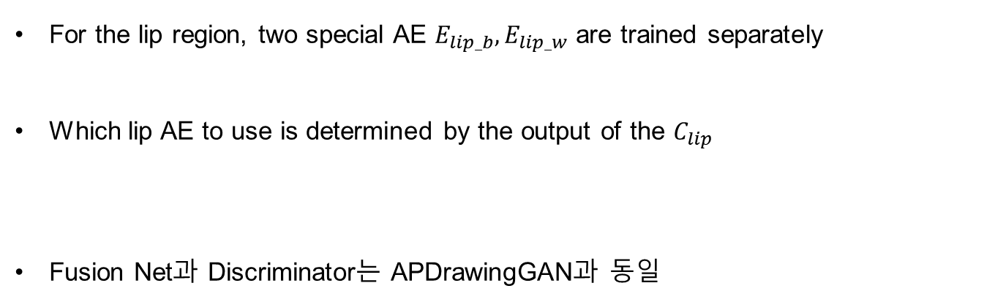
Network Architecture
Auto-encoders for subtle facial features
For the lip region, two special AE $E_{lip_b},E_{lip_w}$ are trained separately
Which lip AE to use is determined by the output of the $C_{lip}$
Fusion Net과 Discriminator는 APDrawingGAN과 동일

Slide 19
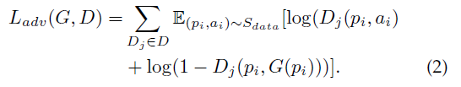
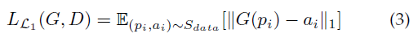
Loss Function
Adversarial Loss and Pixel-wise Loss

Slide 20
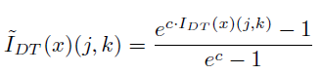
Loss Function
Line-promoting distance transform loss with nonlinear mapping
They apply a nonlinear mapping to the DT
puts stronger penalty on large misalignments and reduces the penalty on small misalignments.
Since small misalignments frequently appear in artist drawings, the non linear mapping can help clean the local messy drawings

Slide 21
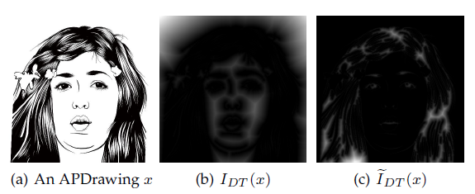
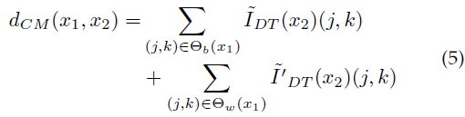
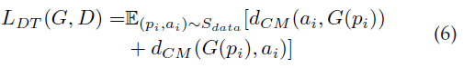
Loss Function
Line-promoting distance transform loss with nonlinear mapping

Slide 22
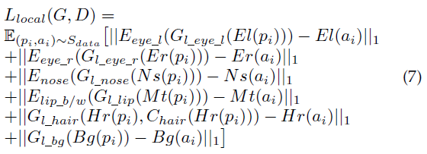
Loss Function
Local transfer loss

Slide 23
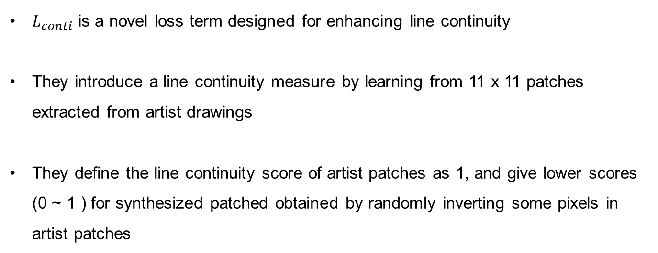
Loss Function
Line continuity loss
$L_{conti}$ is a novel loss term designed for enhancing line continuity
They introduce a line continuity measure by learning from 11 x 11 patches extracted from artist drawings
They define the line continuity score of artist patches as 1, and give lower scores (0 ~ 1 ) for synthesized patched obtained by randomly inverting some pixels in artist patches

Slide 24
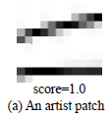
Loss Function
Line continuity loss
White-dominant artist patch : more white pixel than black pixel
First, randomly invert some black pixels and define the line continuity value of r %
as
Then, randomly invert white pixels and define the line continuity value of r %
as

Slide 25
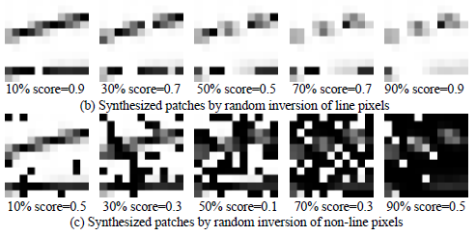
Loss Function
Line continuity loss

Slide 26
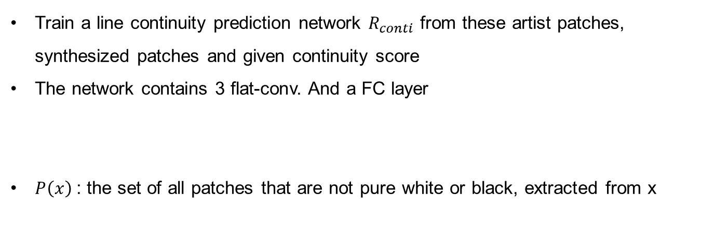
Loss Function
Line continuity loss
Train a line continuity prediction network $R_{conti}$ from these artist patches, synthesized patches and given continuity score
The network contains 3 flat-conv. And a FC layer
$P\left(x\right)$: the set of all patches that are not pure white or black, extracted from x

Slide 27
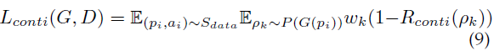
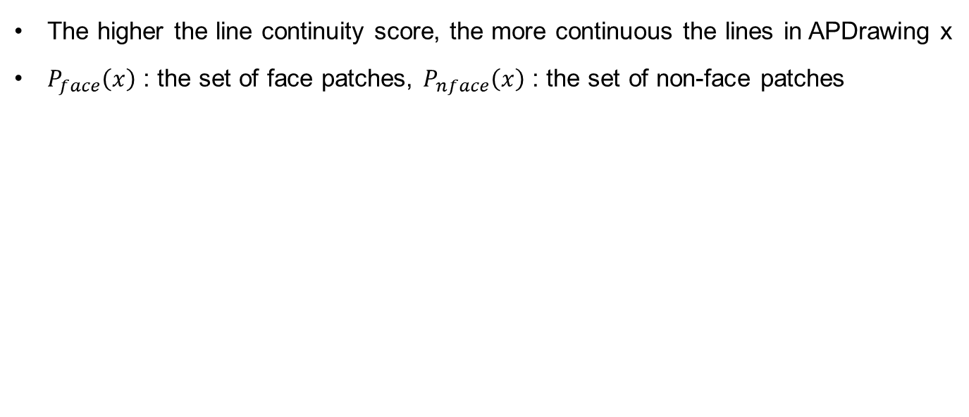
Loss Function
Line continuity loss
The higher the line continuity score, the more continuous the lines in APDrawing x
$P_{face}\left(x\right)$ : the set of face patches, $P_{nface}\left(x\right)$ : the set of non-face patches

Slide 28
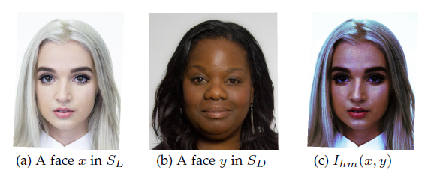
Training APDrawingGAN++
Histogram Matching Augmentation
HM augmentation generates face photos with different face colors to augment the tranning set

Slide 29
Training APDrawingGAN++
Histogram Matching Augmentation
They use contrast limited histogram matching which restricts the slope of the mapping function to avoid extreme and unnatural recolorizations
To avoid any influence from the background, they only match the histogram in face regions
Improve the balance of face colors and makes better suited to faces over a wide range of colors
Apply HM to each face photo in the training set 7 times using 7 randomly selected images from APDrawing Datasets.

Slide 30
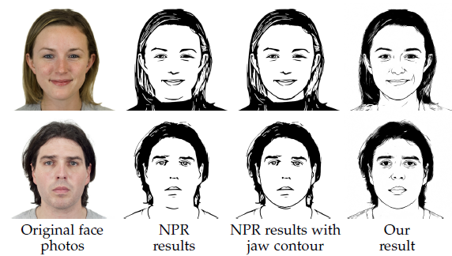
Training APDrawingGAN++
NPR
사전 훈련 단계에서 대략적인 근사치로 사용하기 위하여.
사전 훈련 후에 APDrawing을 추가하여 혼합 Training을 함

Slide 31
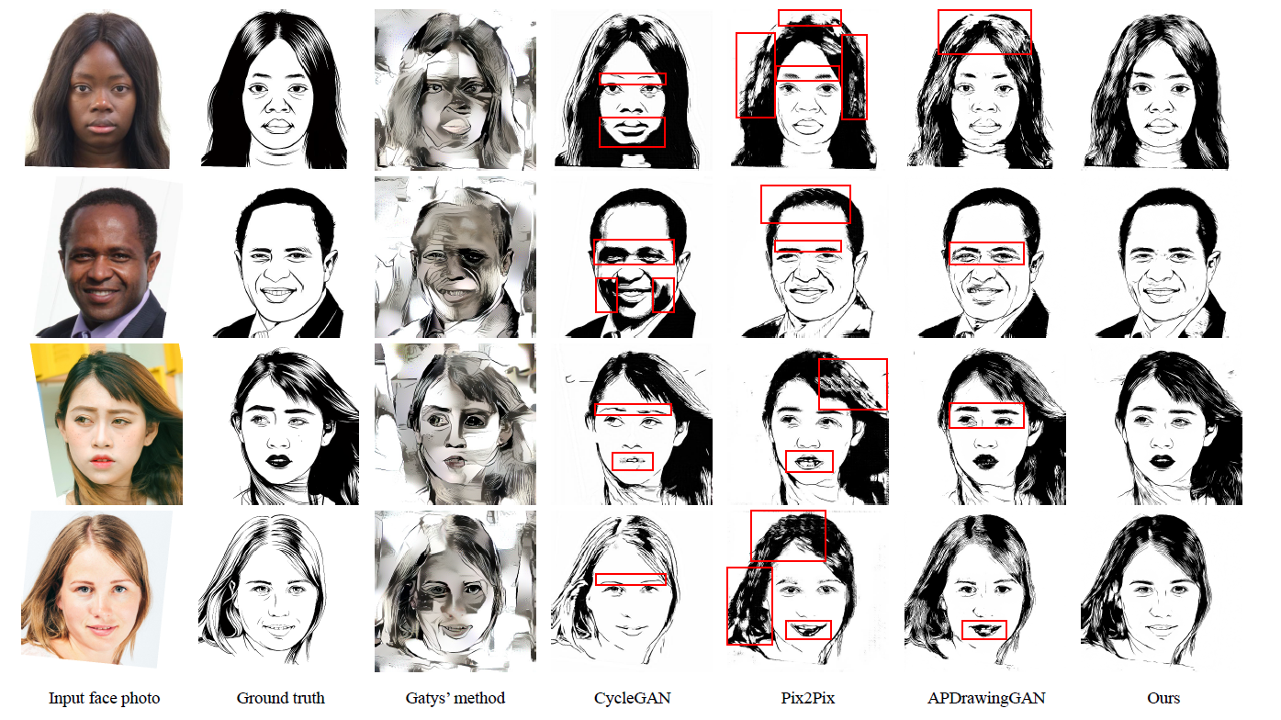
Experiments
Comparison with state of the art

Slide 32
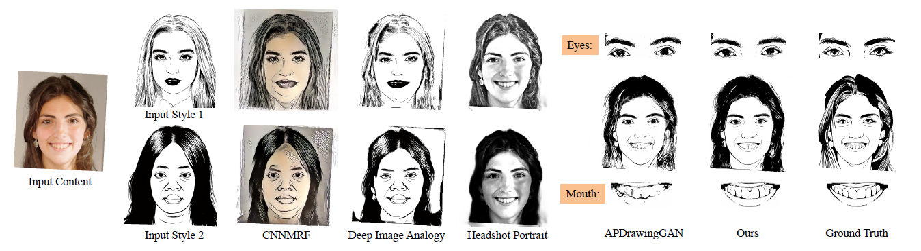
Experiments
Comparison with state of the art

Slide 33
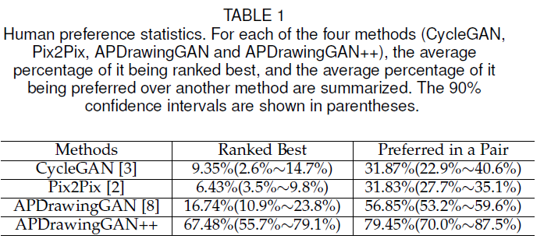
Experiments
Comparison with state of the art
Study with 102 participants to compare APDrawingGAN++
All 70 test pairs were used in study (group any two of them)

Slide 34
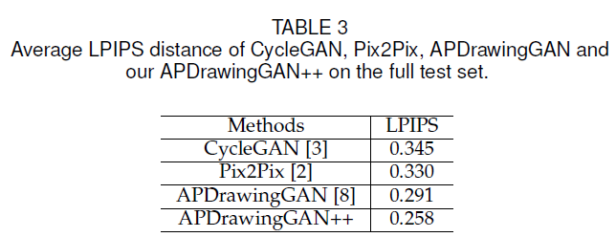
Experiments
Comparison with state of the art
A perceptual similarity metric, to correlate well with human perceptual similarity

Slide 35
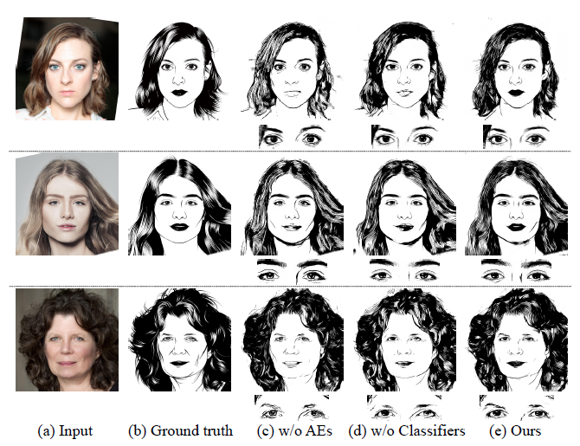
Experiments
Comparison with state of the art

Slide 36
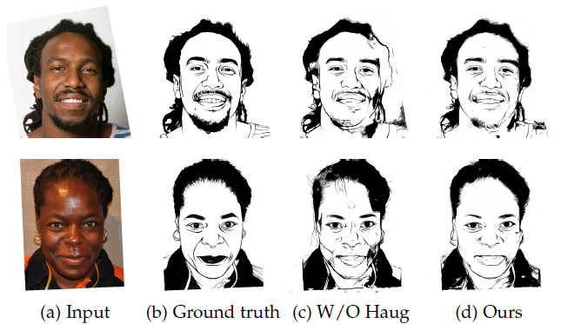
Experiments
Ablation study in APDrawingGAN++
Ablation study on histogram matching augmentation

Slide 37
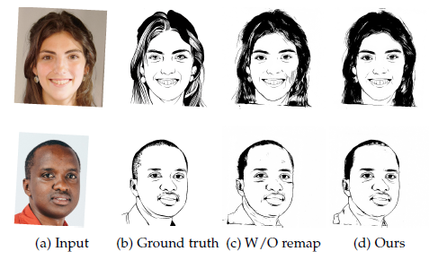
Experiments
Ablation study in APDrawingGAN++
Ablation study on DT loss nonlinear mapping

Slide 38
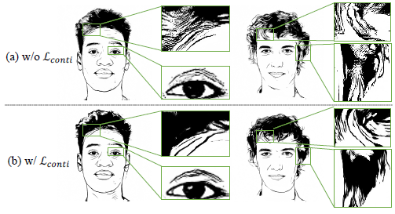
Experiments
Ablation study in APDrawingGAN++
Ablation study on line continuity loss

